Slide 1
Practice: Information Representation (Week 2)

Slide 2
Number systems

Slide 3
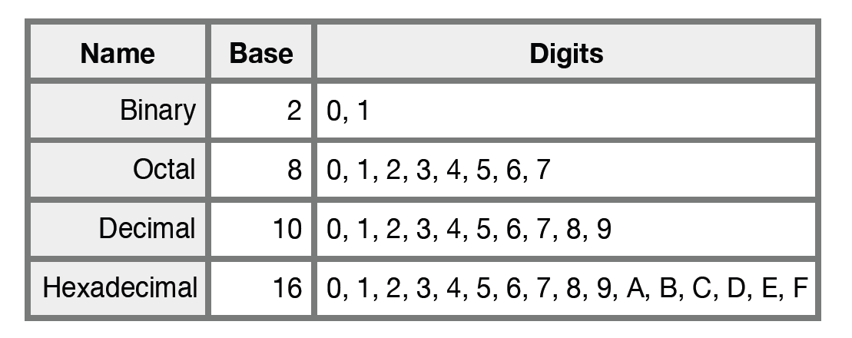
Commonly Used Number Systems

Slide 4
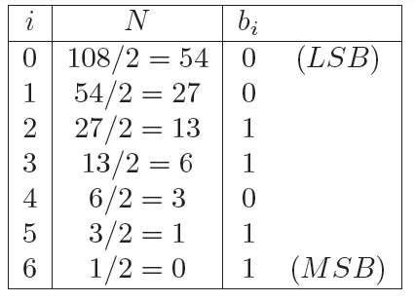
Decimal to Binary Conversion for Integers
Converting 108 to binary

Slide 5
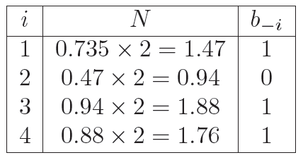
Decimal to Binary Conversion for Fractions
Converting 0.735 to binary
Truncation
(유효 소수점 이하는 버림)

Slide 6
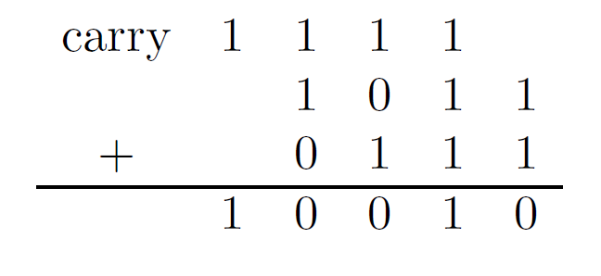
Overflow
An overflow occurs when a computation produces a value that falls outside the range of values that can be represented
The carry bit from the MSB indicates an overflow occured
overflow

Slide 7
One’s Complement Representation
One of the methods to represent a negative number
Not popular
The bitwise inversion (flipping 0’s for 1’s and vice-versa) of a negative number’s positive counterpart

Slide 8
Two's Complement Representation
The most common method of representing signed integers internally in computers
Conversion
Convert the number to its ones’ complement
Then one is added to the result to produce its two’s complement

Slide 9
Practice

Slide 10
Practice 1
Convert the following numbers from the given base to the other three bases. Show the processes of your conversion.
Decimal | Binary | Octal | Hexadecimal
369.3125
 | 10111101.101
 |  | 326.5
 |  |  | F3C7.A

Slide 11
Practice 2
Convert the following decimal numbers to 8-bit 2's complement numbers or indicate that the decimal number would overflow the range. (show your conversion process or give the reasons why they overflow)
42
-63
124
-128
133

Slide 12
Practice 3
Convert the following decimal numbers to 6-bit 2's complement binary numbers and add them. Indicate whether or not the sum overflows a 6-bit result. Show the addition process or give the reasons if they overflow.
16 + 9
27 + 31
-4 + 19
3 + (-32)
-16 + (-9)
-27 + (-31)

